Slide 1
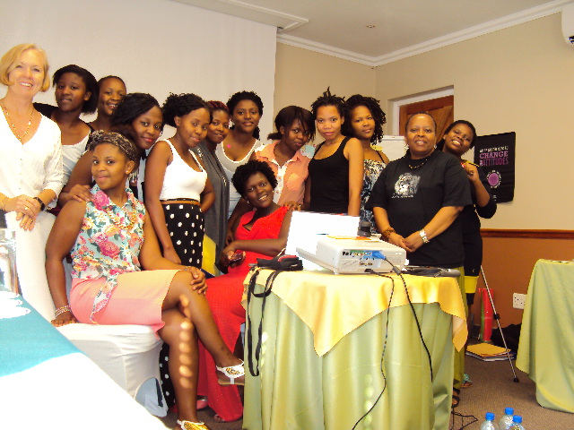
Dialogue to address sexual violence at a South African university
Sandisiwe Gaiza, Zethu Jiyana, Melissa Lufele, Bongiwe Maome, Lelethu Mlobeli, Asisipho Mntonga, Takatso Mohlomi, Wandiswa Momoza, Happy Mthethwa, Elethu Ntsethe, Zikhona Tshiwula, Zamahlubi Mabhengu, Thina Kamnqa, Sonwabe April
Naydene de Lange (NMMU, SA)
Relebohile Moletsane (UKZN, SA)
Claudia Mitchell (Mcgill, Canada)

Slide 2
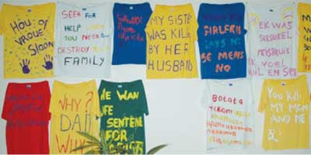
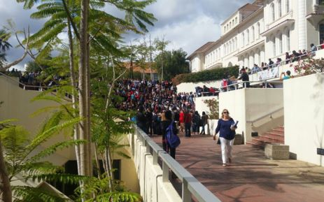
Sexual violence in South Africa
Stellenbosch University, 11 March 2016
Notes:
Clothesline project… violence against women

Slide 3
Sexual violence on campus in South Africa…
Sexual violence within as well as outside sexual relationships
has far reaching public health and human rights implications and
is a continuing focus of research in South Africa (Wood et al., 2007; De Lange et al., 2015).
Sexual and gendered violence in the higher education sector is a worldwide concern (Phipps & Smith, 2012;
Schaffer, 2016)
For example, research in SA points to
Coercive sexual practices and gender-based violence on university campus (Clowes et al., 2009)
Transactional sex on university campus (Schefer et al., 2012).
Institutional violence in higher education (Dowler et al., 2014)
Policies for sexual harassment in higher education: Two steps forward and three steps somewhere
else (Bennett, 2009)
How do we prevent sexual violence in the 21st century? How do we change institutional cultures?
Notes:
College and universities are high-risk settings for sexual and relationship violence ( Moynihan, et al. 2015)

Slide 4
Just as Bennett (2014) we stress “‘dialogue’ because, given the scale of the gender-based violence in our … country, dialogue among all of us involved in seeking strategic and powerful solutions is essential.”

Slide 5
We ask…
How can participatory initiatives (including digital media practices) with young women, a group typically excluded from policy dialogue, inform practices, policies, programs and services related to their own safety, security and well-being?

Slide 6
Identifying the issues and taking action
Cellphilms
Policy Posters
Action Briefs
Participatory Visual Research
Dialogue

Slide 7
Cellphilms: Prompt
“Make a cellphilm about ‘feeling not so safe’ in and around the university as a woman student.”

Slide 8
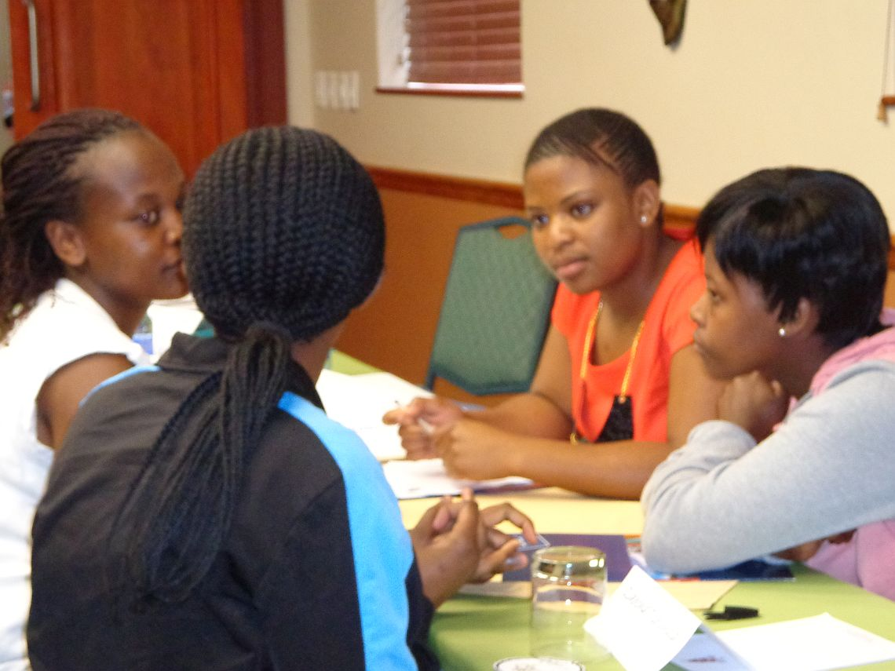
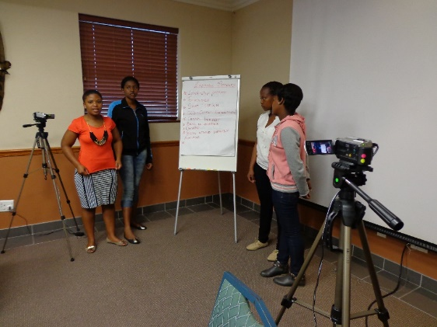
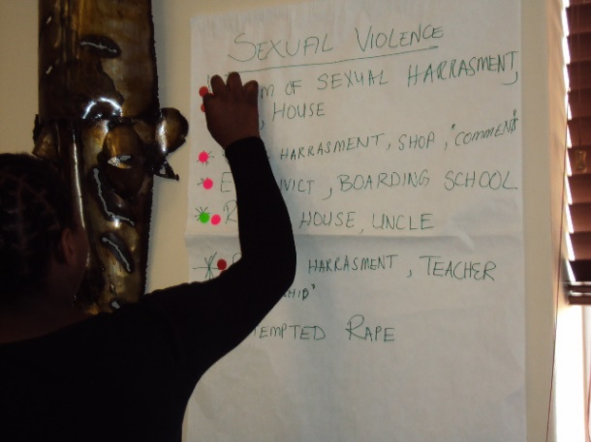
Cellphilms: Identifying the issues

Slide 9
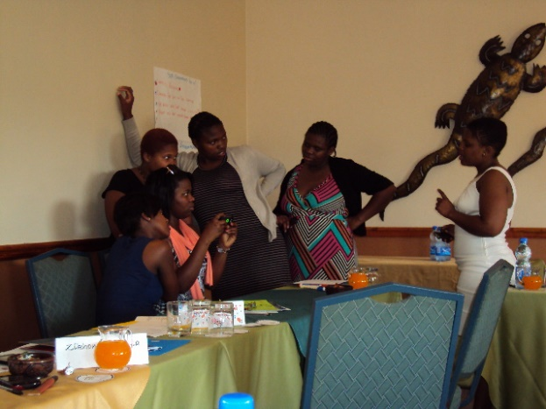
Cellphilms: Planning our stories

Slide 10
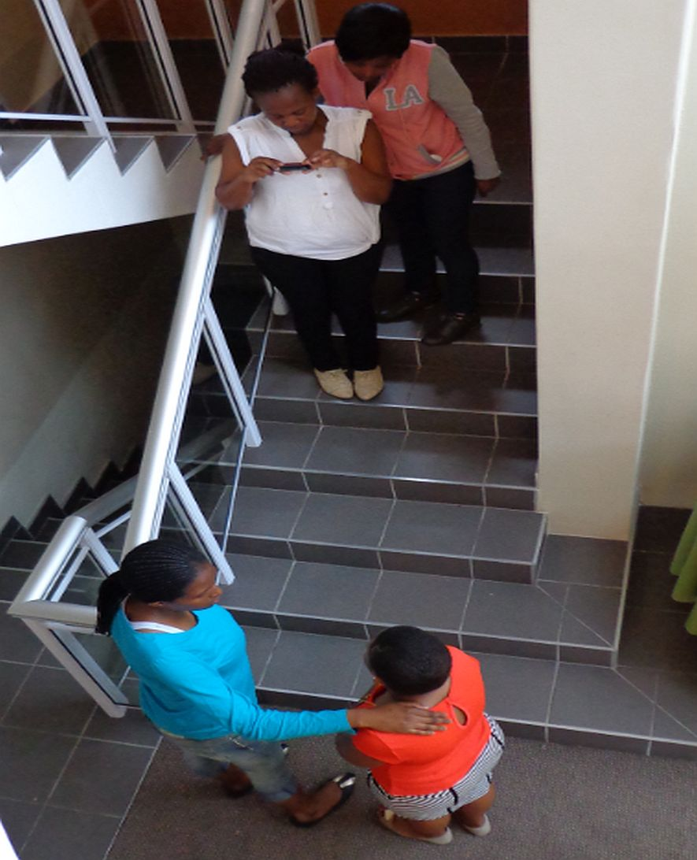
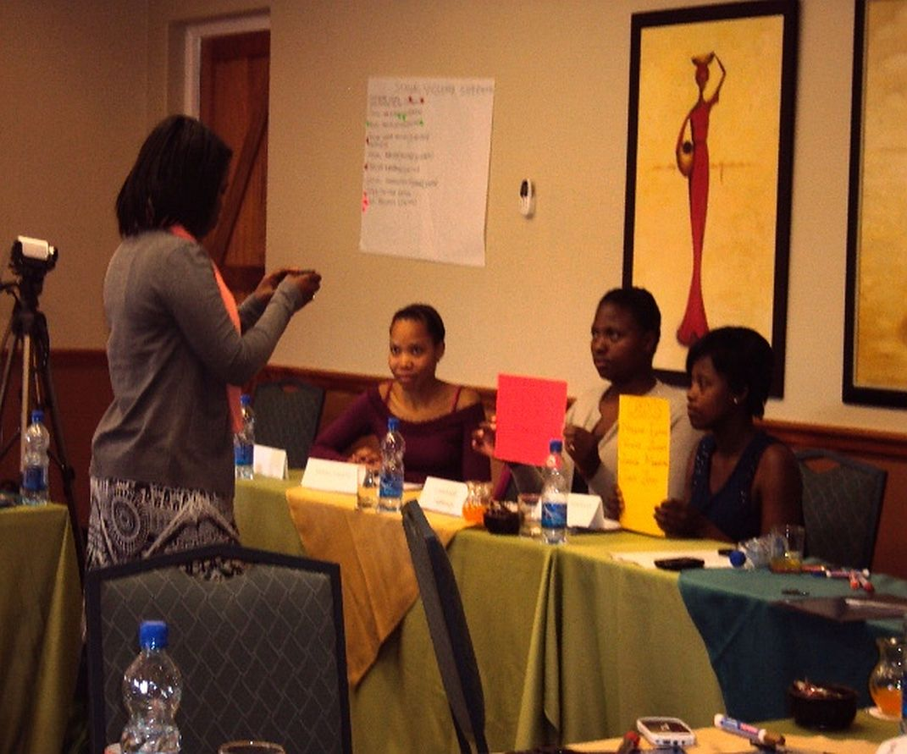
Cellphilms: Filming our stories

Slide 11
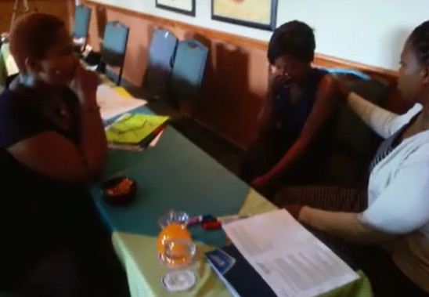
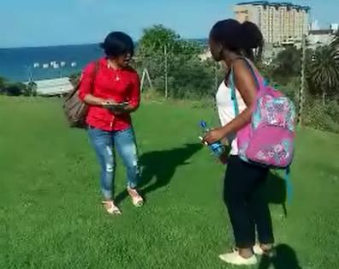
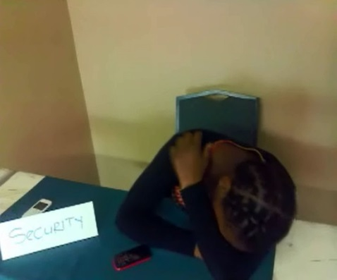
Four cellphilms
Getting into Res
The game
Xanadu square
Careless Securities

Slide 12
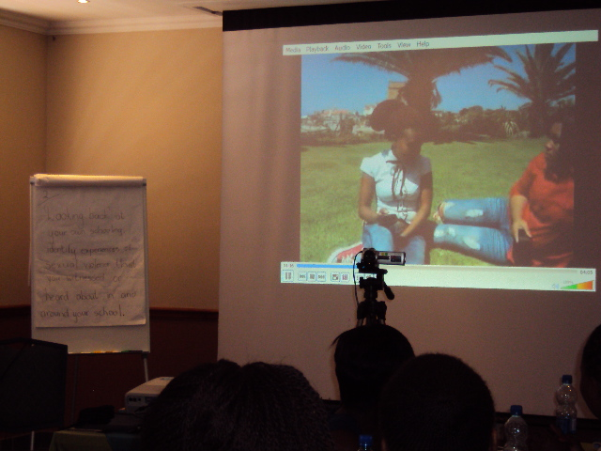
Cellphilms: Screening

Slide 13
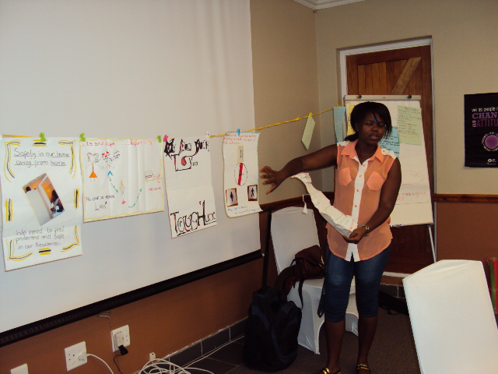
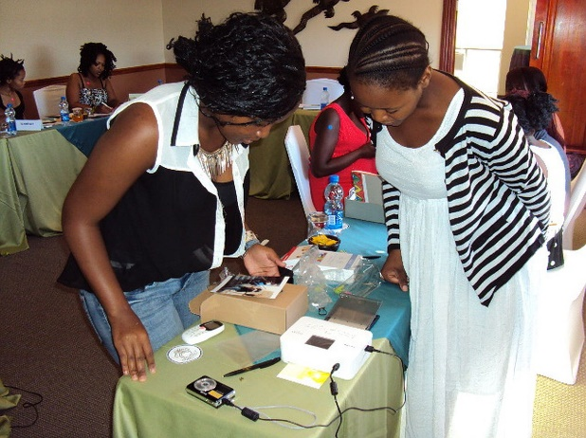
Policy posters: Representing the issues visually

Slide 14
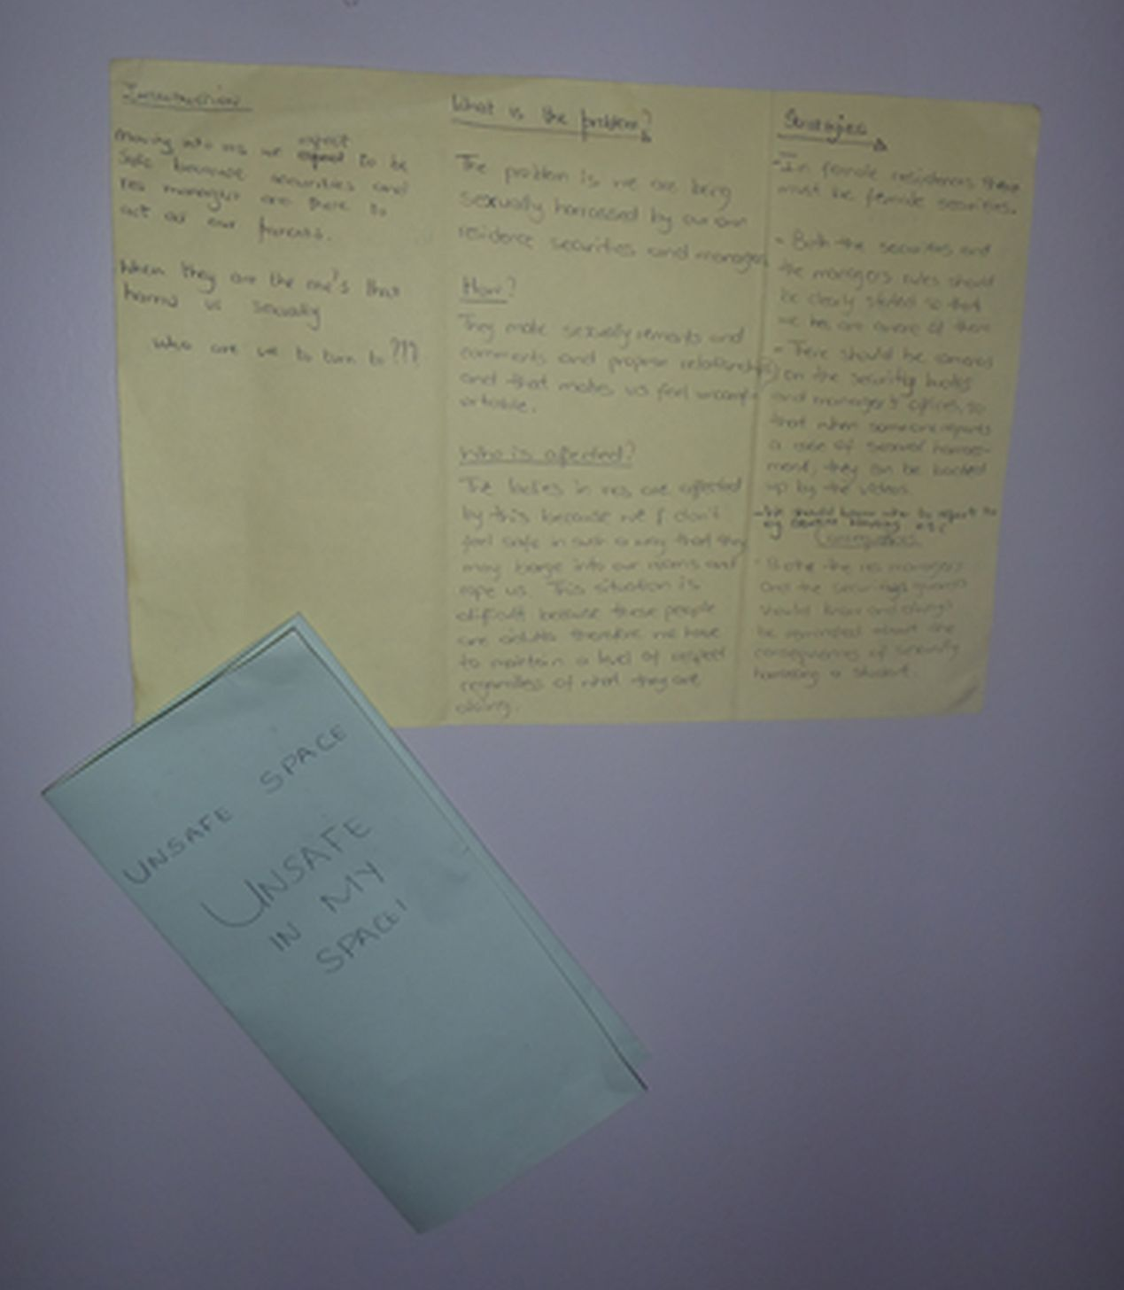
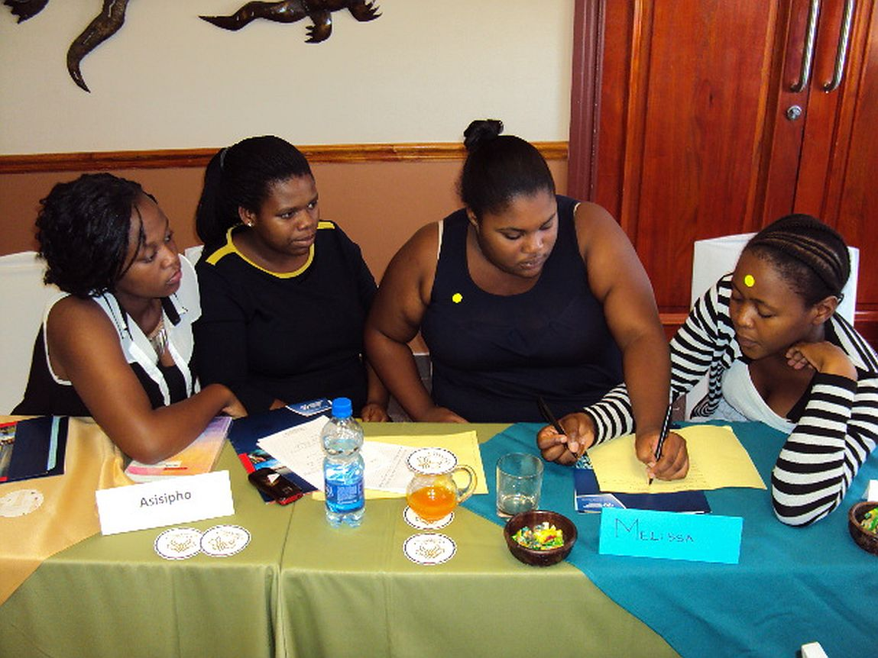
Action Briefs: Generating our solutions

Slide 15
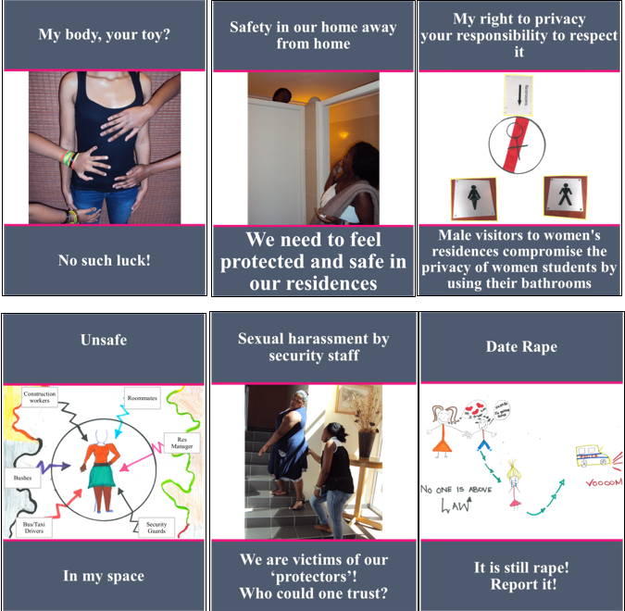
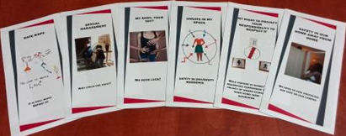
Digitised productions
Notes:
Using MS publisher, our research assistant digitized the six handmade policy posters. This enhanced the quality of the participants’ work. Several sets were printed, ready to be handed to the policy makers.

Slide 16
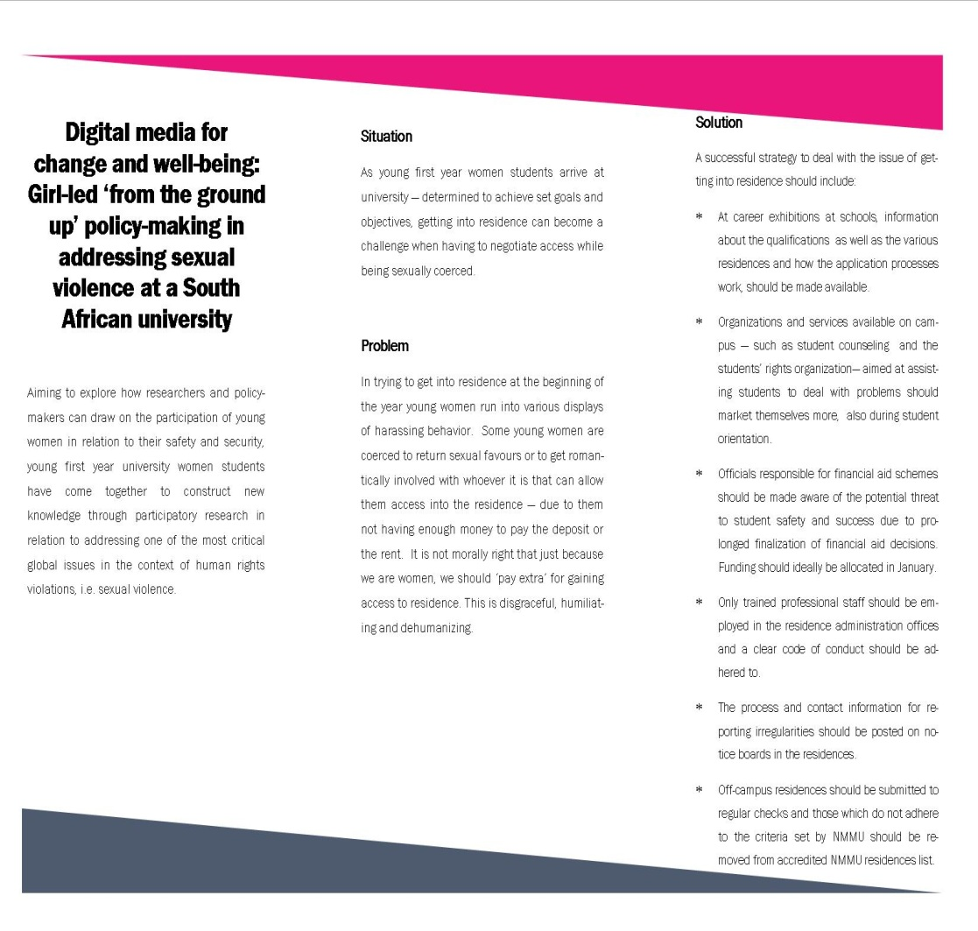

Slide 17
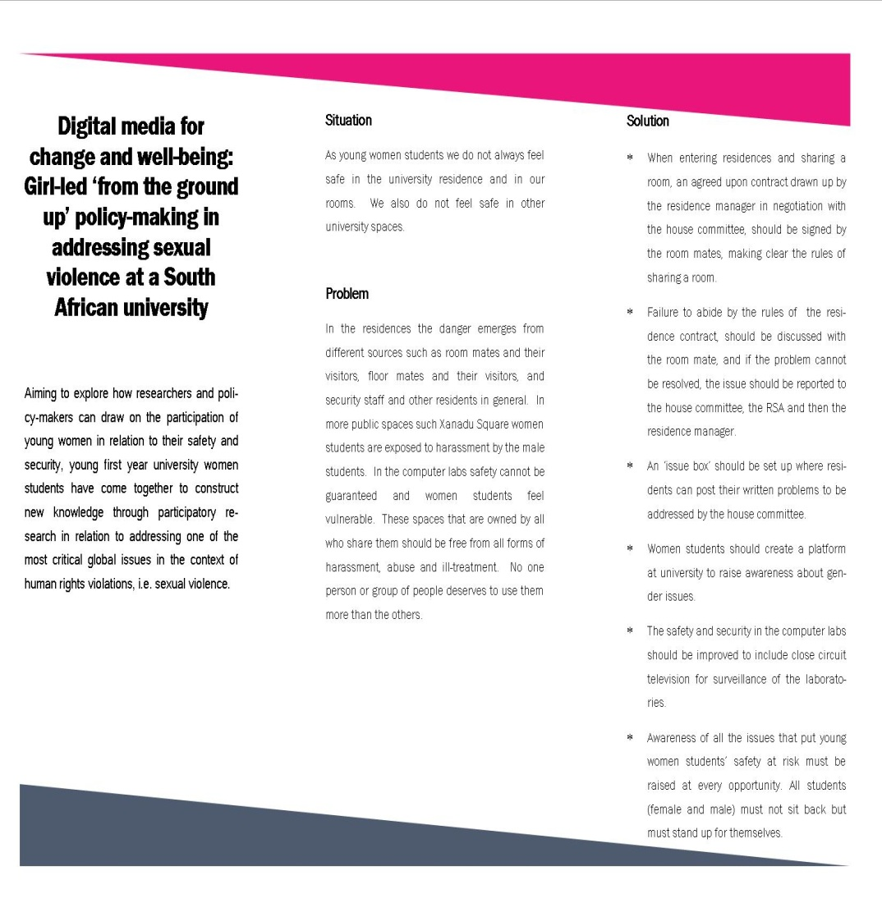

Slide 18
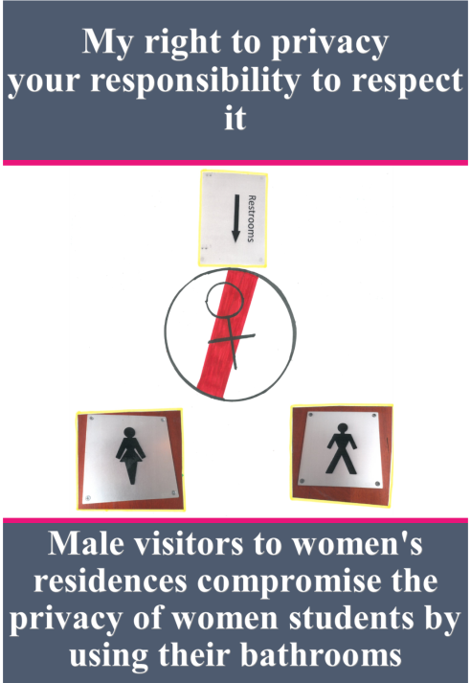
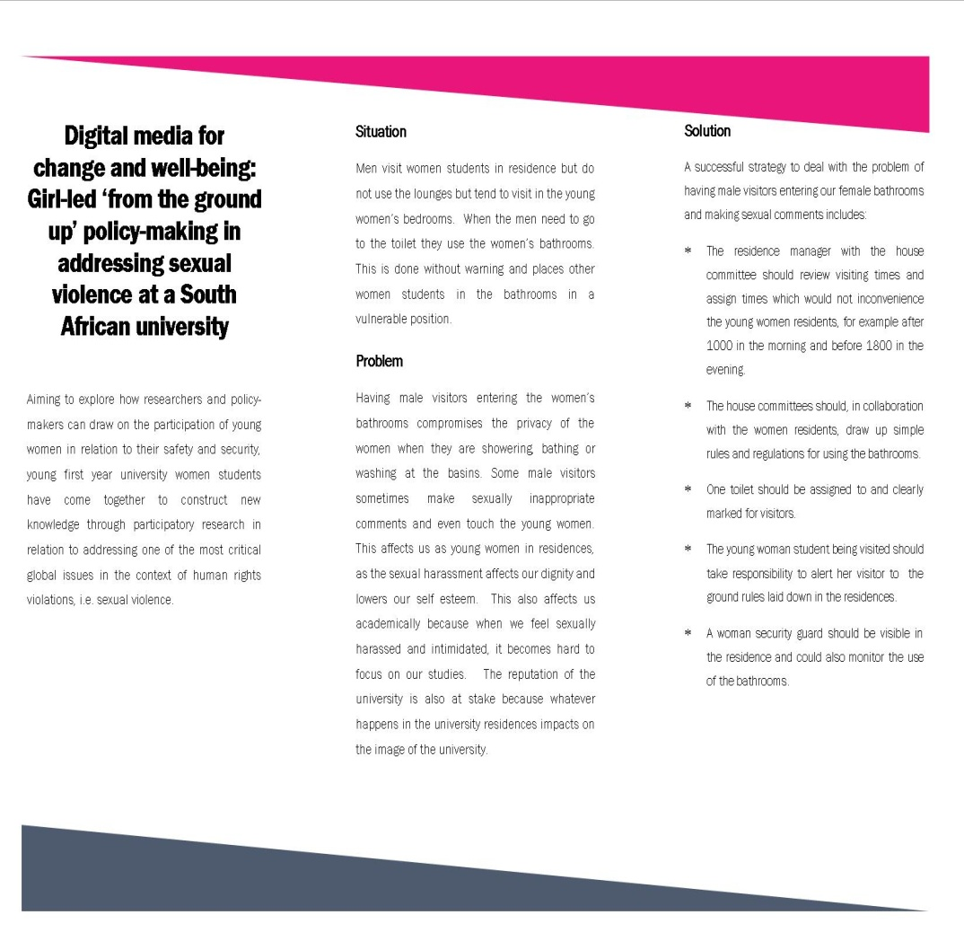

Slide 19
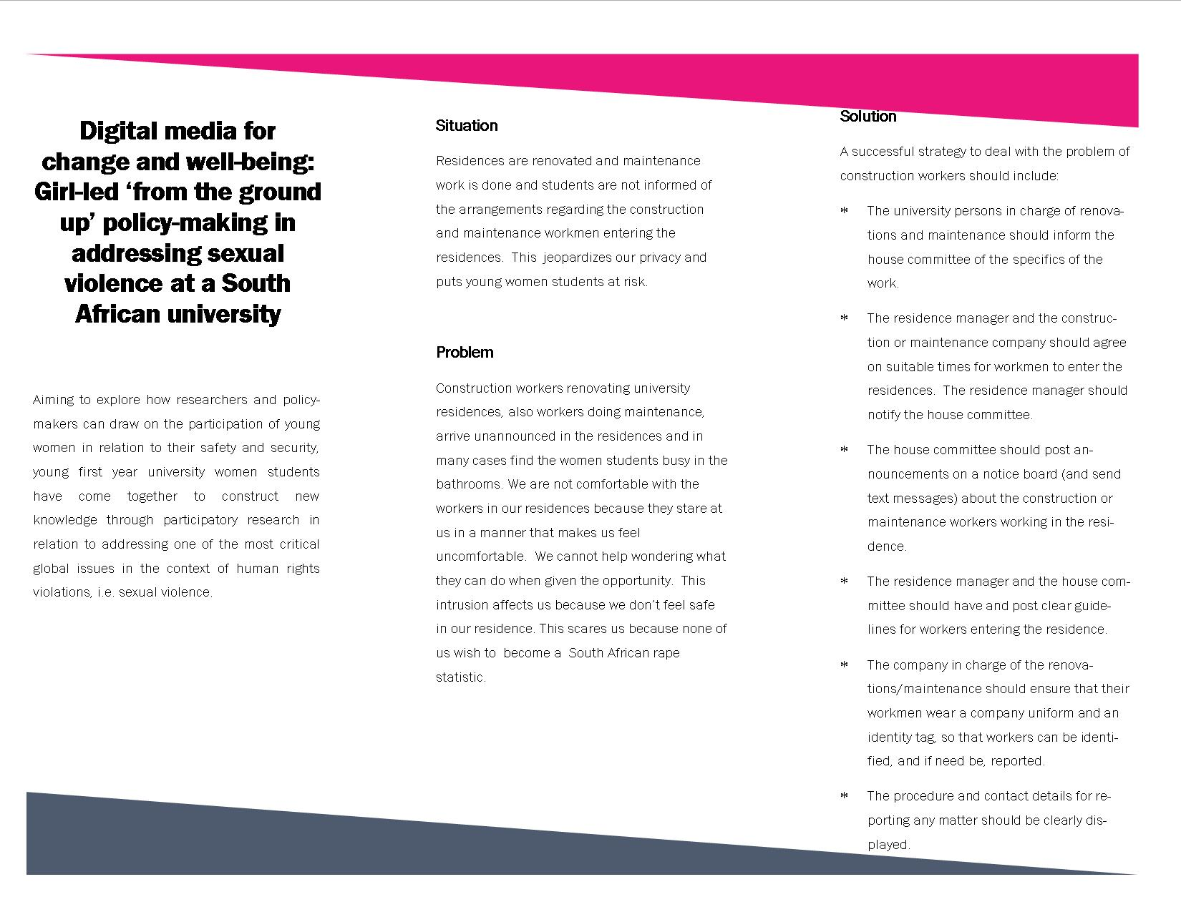

Slide 20
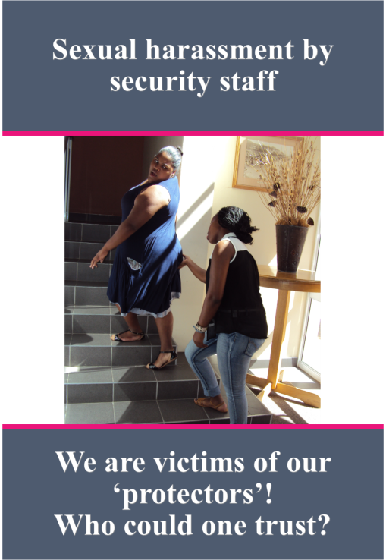
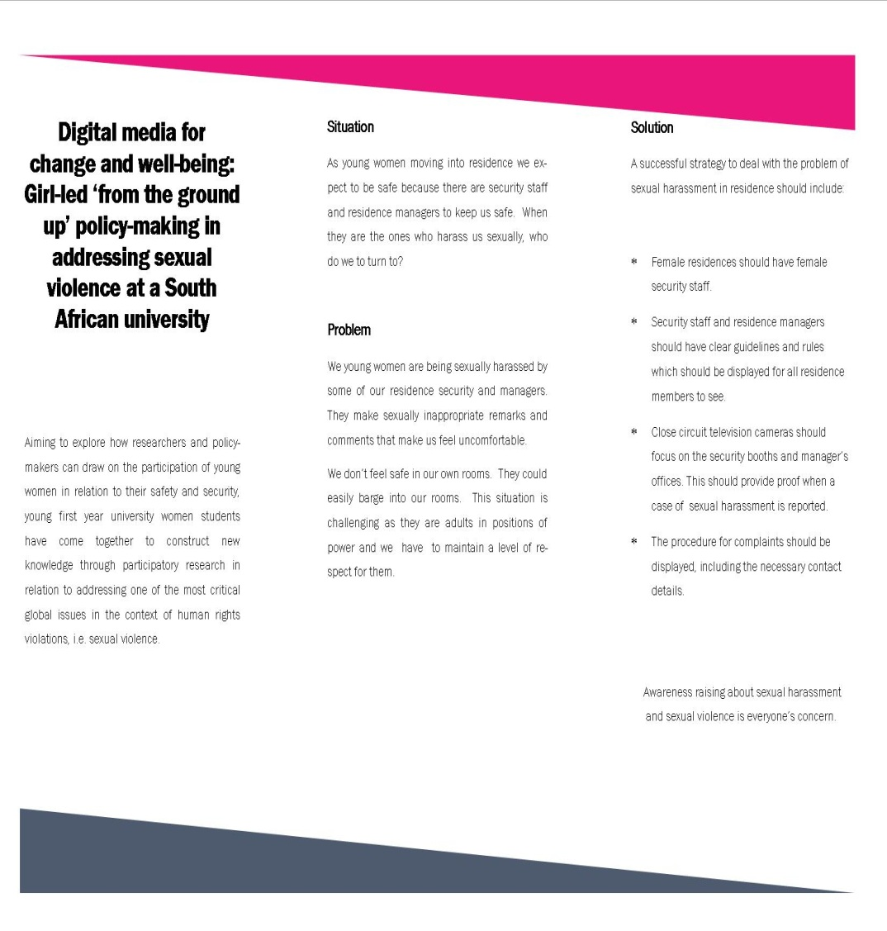

Slide 21
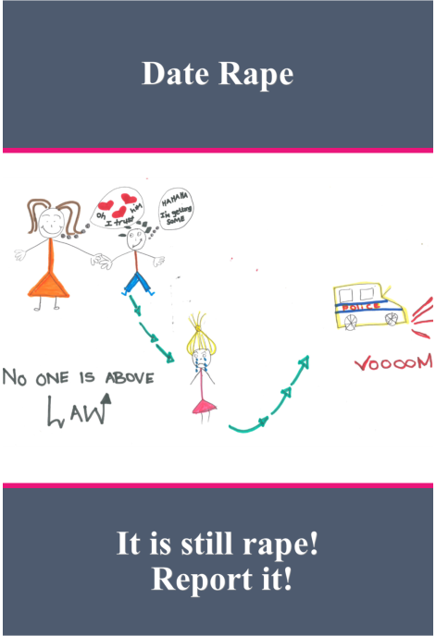
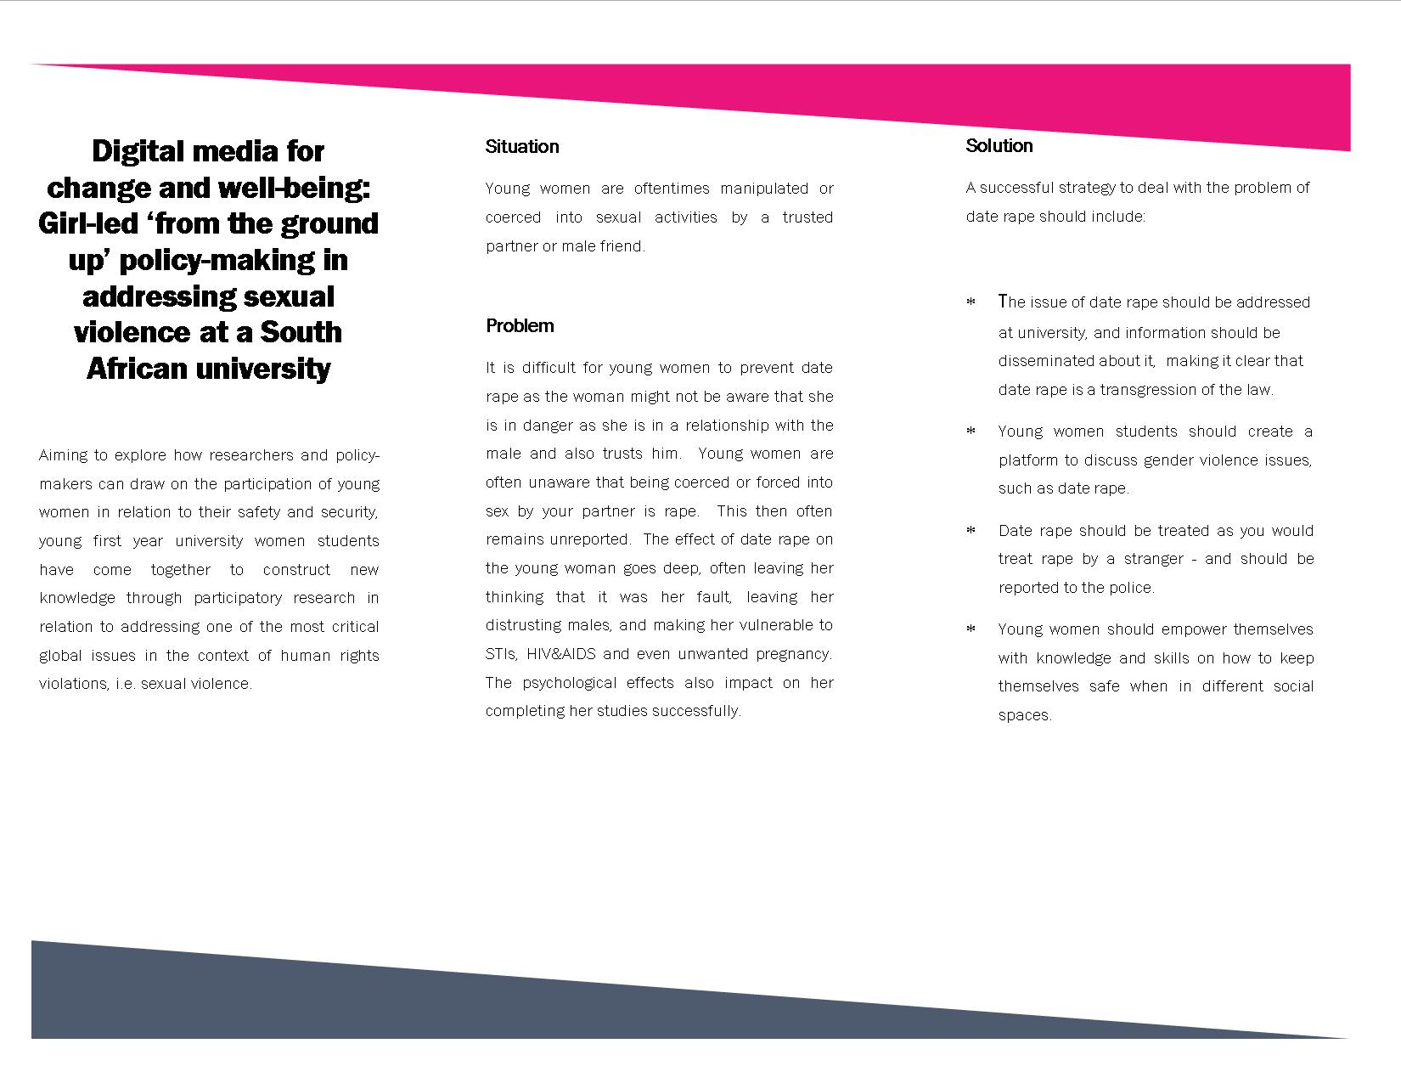

Slide 22
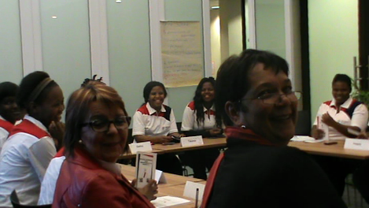
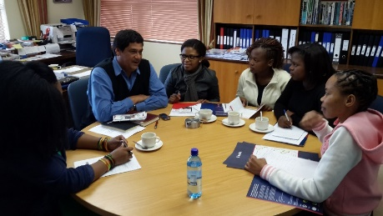
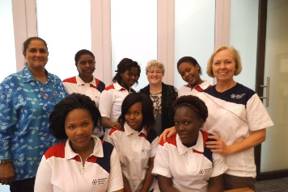
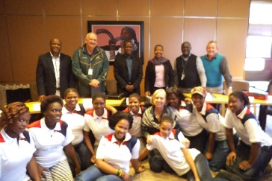
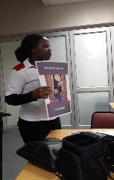
Dialogue: Getting the findings to university policymakers
1
DVC Research
2
Director Centre for the Advancement of non-
Director Institutional Planning,
4
& Engagement
Dean Education
racialism and Democracy
Director Transformation Monitoring and Evaluation
5 6 …..
3
DVC Institutional Support
Dean of Students
Residence Manager
Head of Protection Services
SRC
and student organi-za-
tions
On
George campus
Aca-
demics
and students

Slide 23
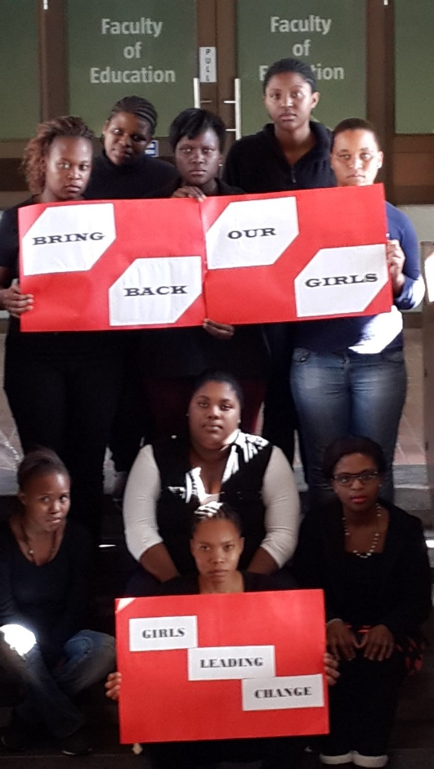
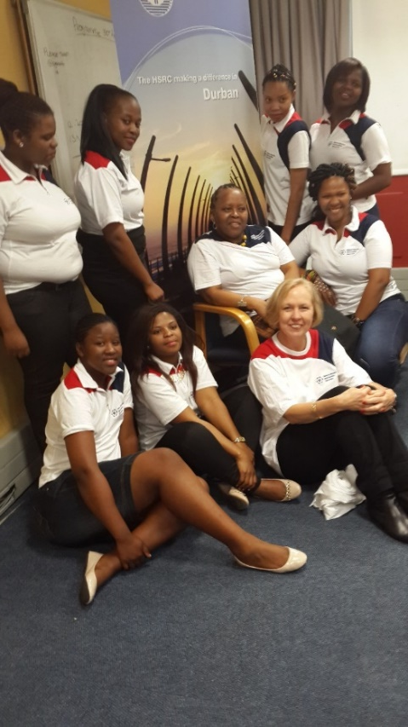
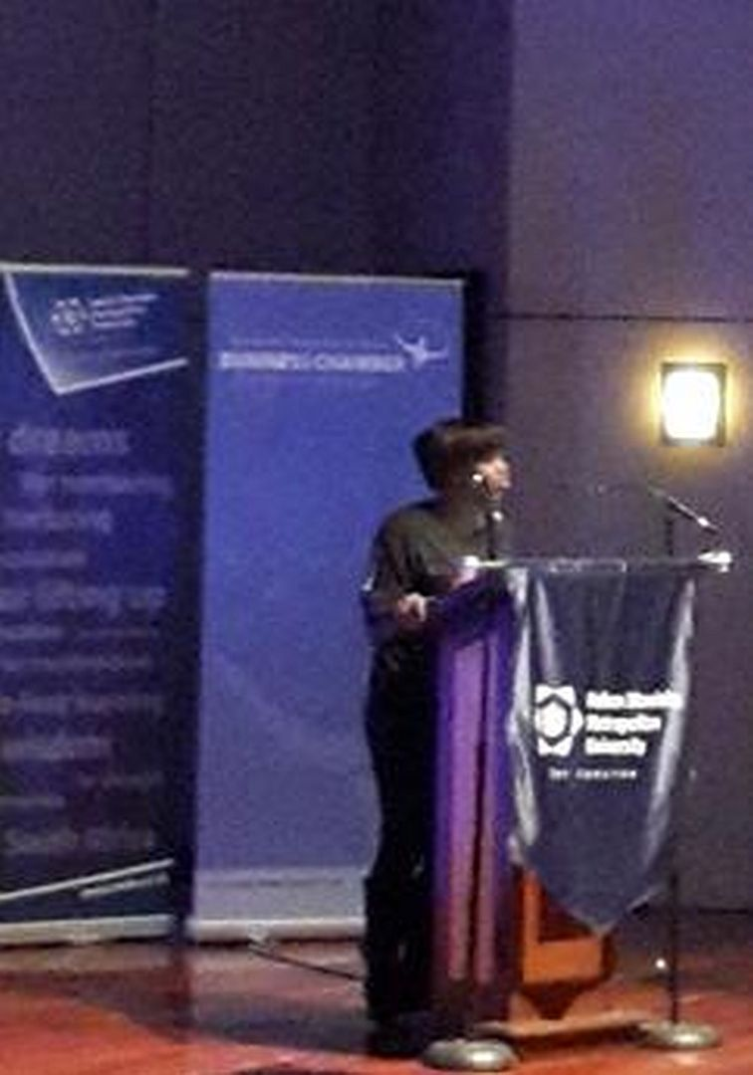
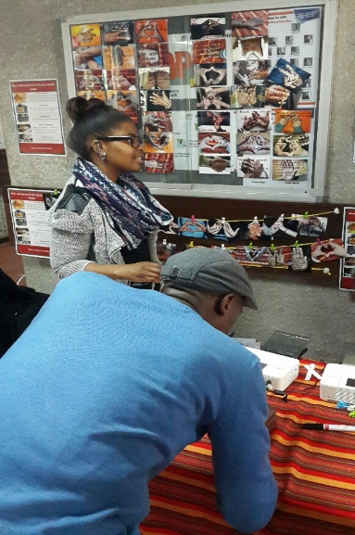
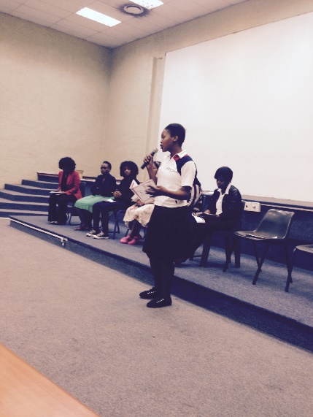
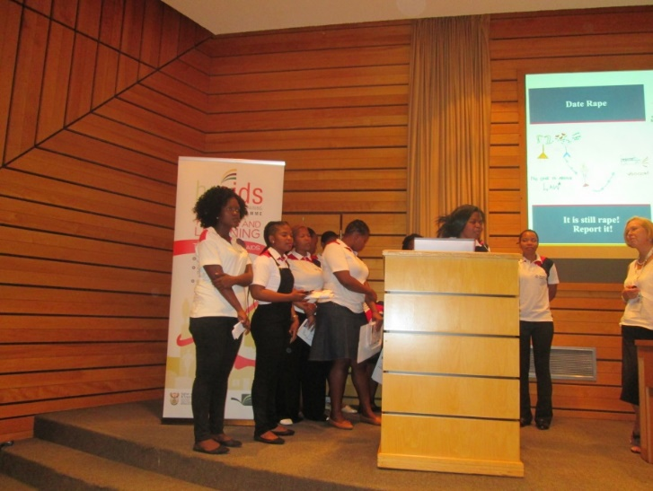
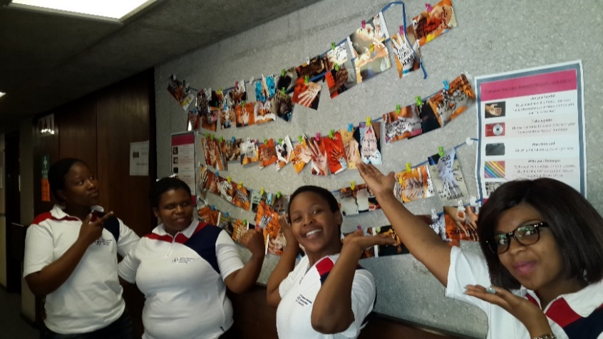
How are we taking this dialogue forward?
Notes:
Local and national

Slide 25
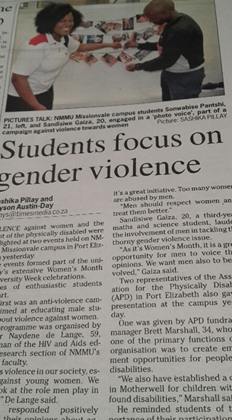
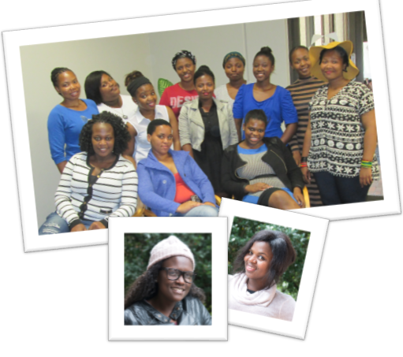
Reflecting on our work

Slide 26
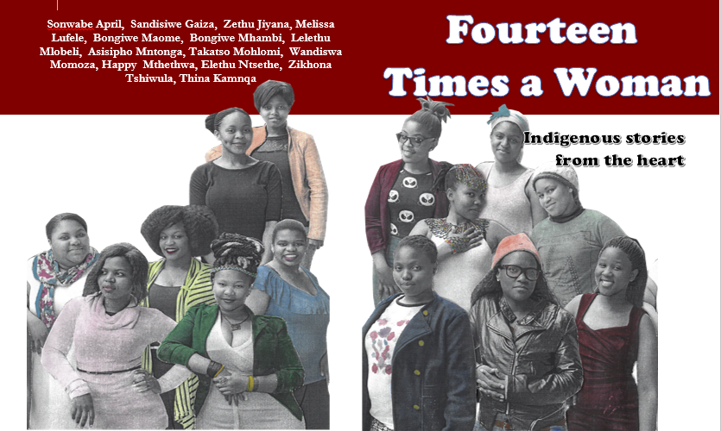
Publications
De Lange, N., Moletsane, R. & Mitchell, C. (2015). Seeing how it works: A visual essay about critical and transformative research in education. Perspective in Education, 33(4).

Slide 27
Taking the project further … Digital media for change and well-being: Girl-led ‘from the ground up’ policy-making in addressing sexual violence at a South African university (NMMU: 2013-2014) Networks for change and well-being: Girl-led ‘from the ground up’ policy-making in addressing sexual violence in Canada and South Africa (SSHRC/IDRC: 2014-2020)

